Slide 1
sos4loveproject
Art School of Gerakas
ATHENS-GREECE
January-February 2018

Slide 2
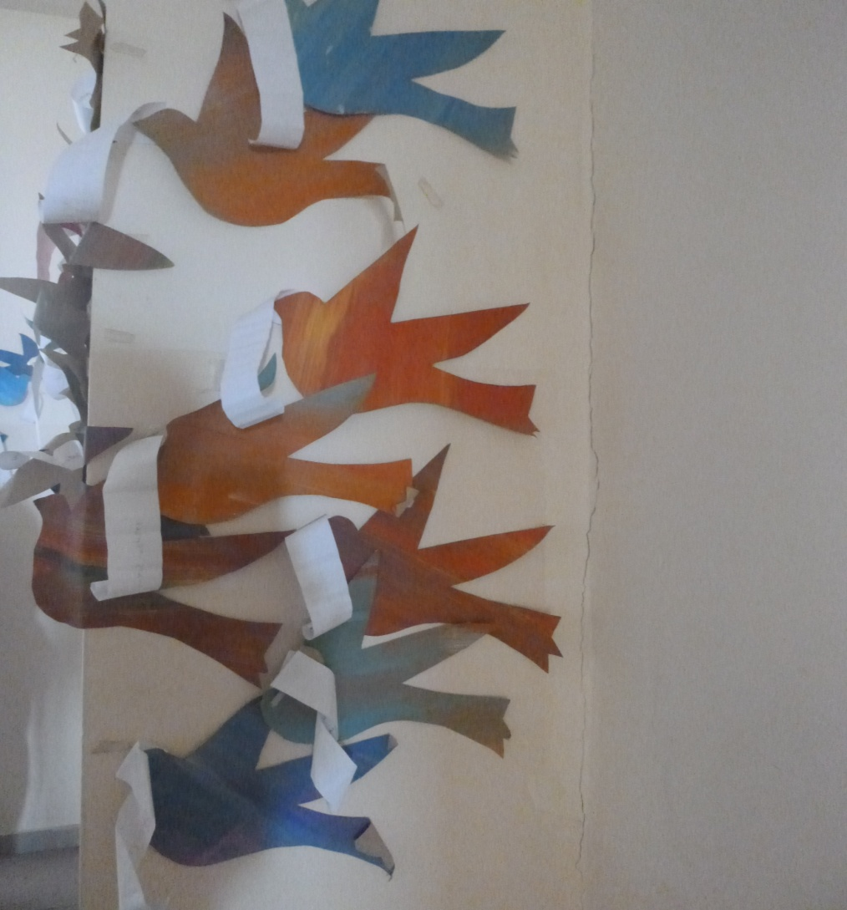
Sos4love-messages
Students’ creation

Slide 3
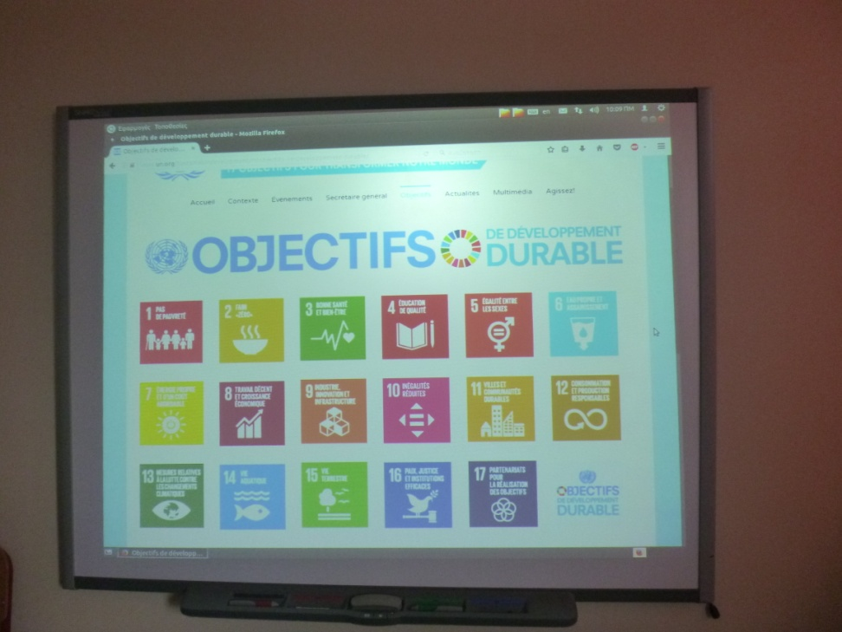
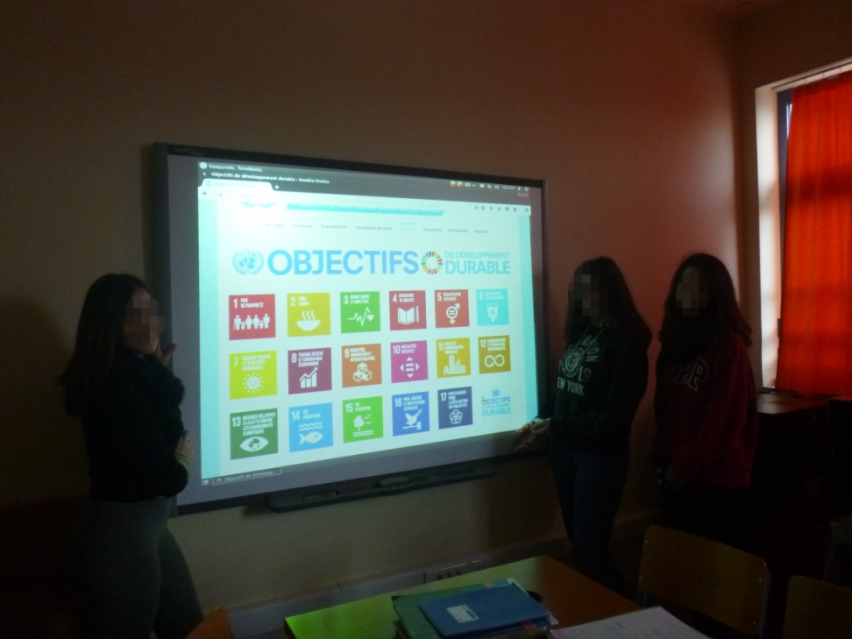
Week 1 initiation

Slide 4
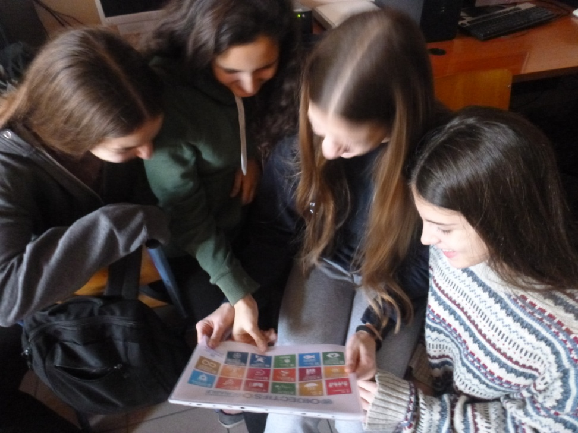
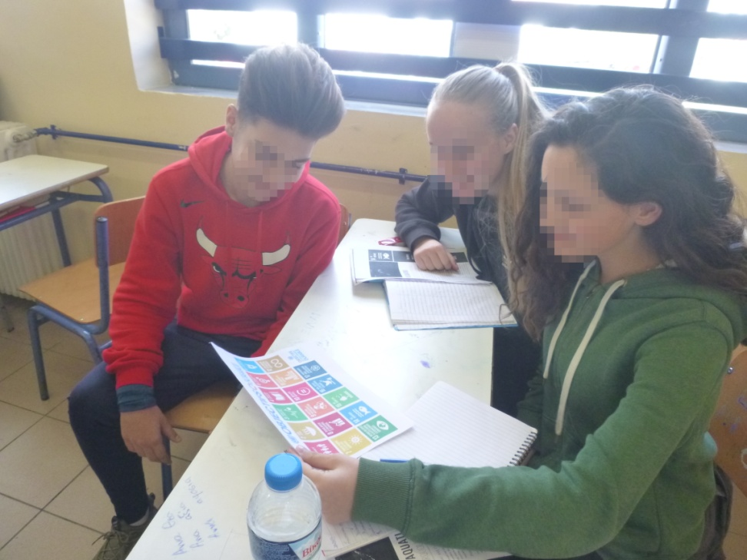
Week 1

Slide 5
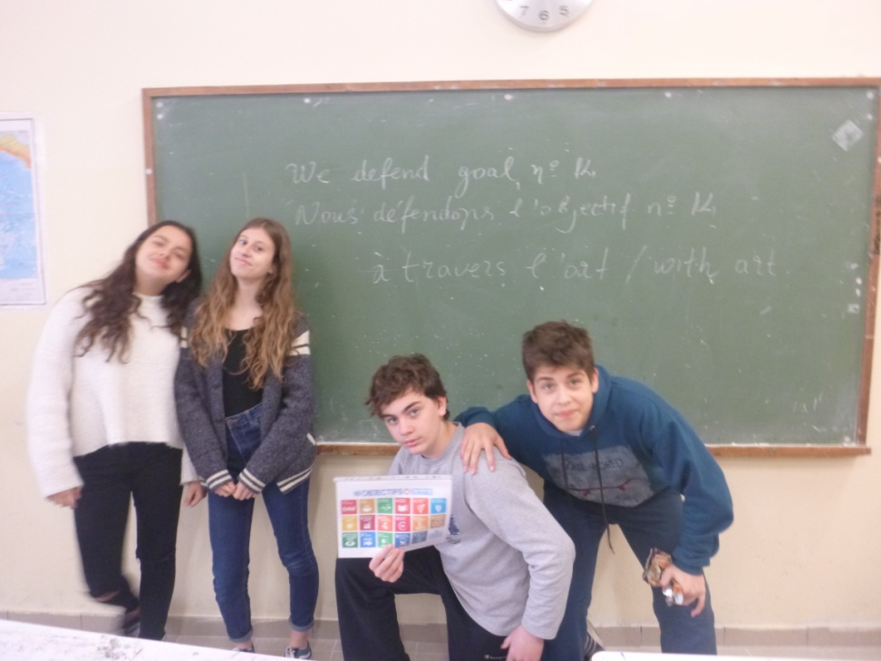
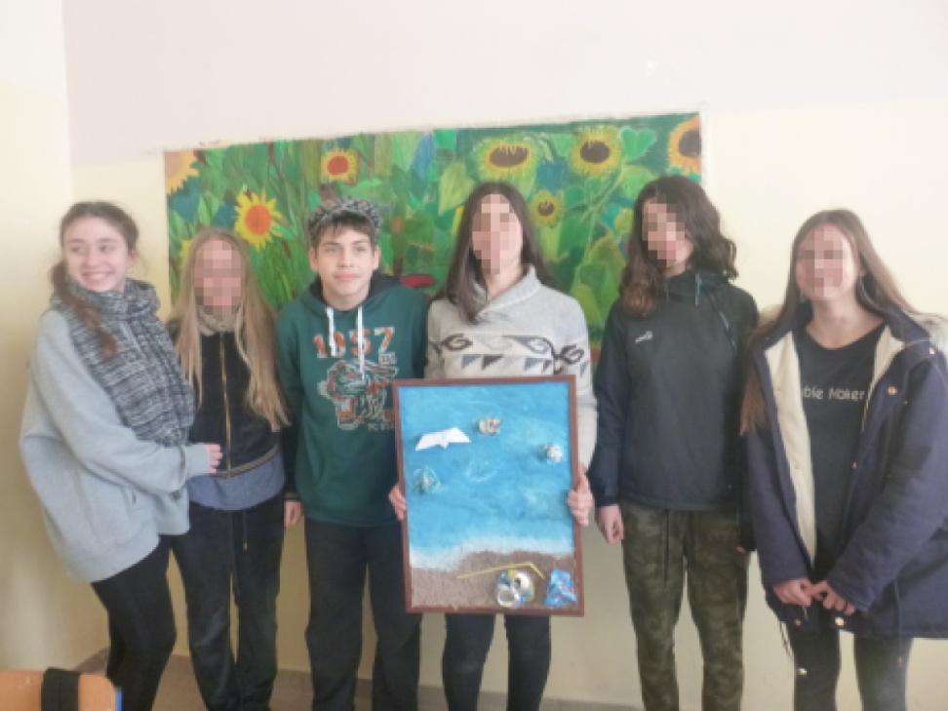
Week 2 research

Slide 6
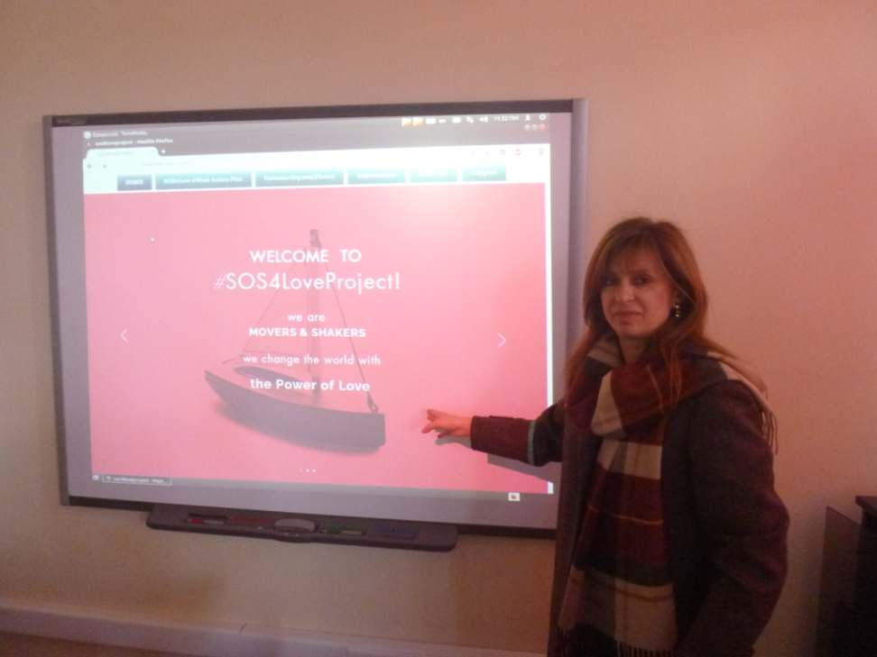
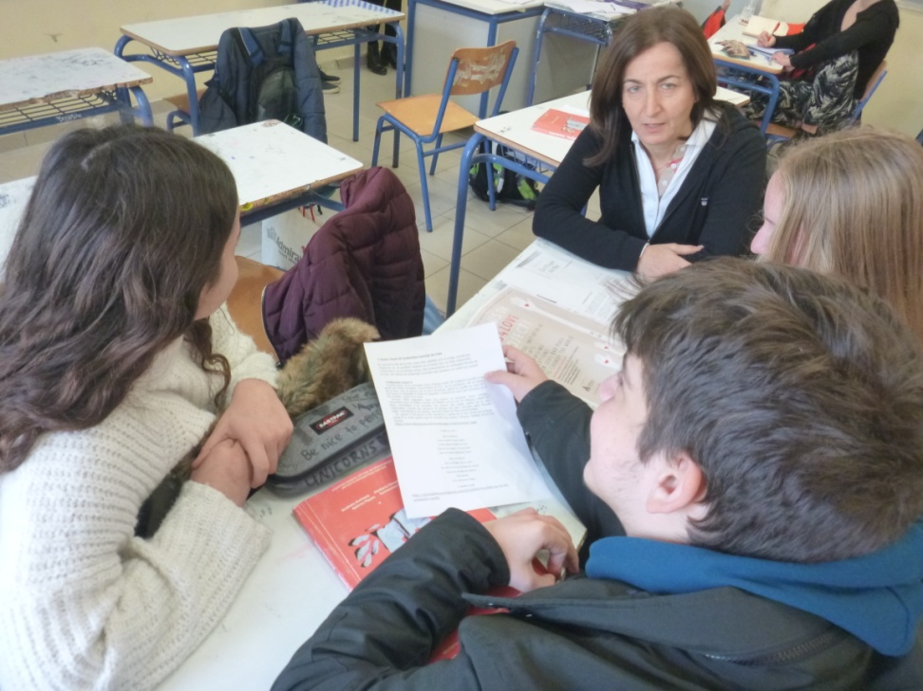
Teachers on duty

Slide 7
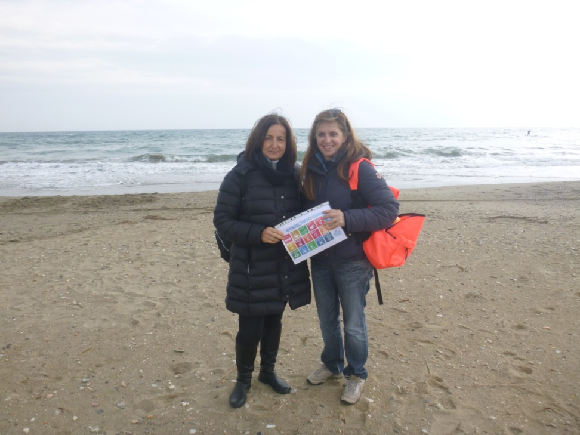
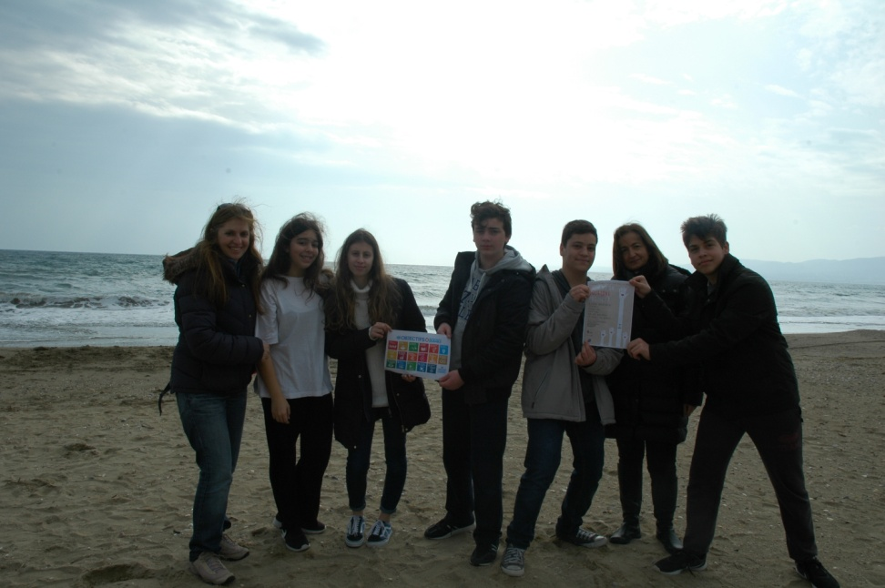
Week 3 movie filming

Slide 8

Week 4 take action for

Slide 9
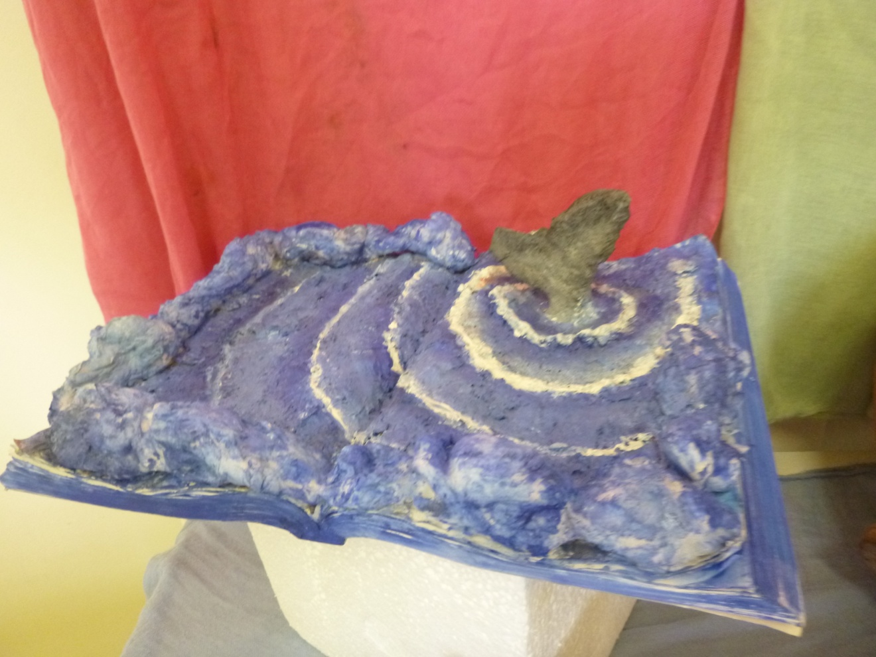
Ocean in a book , Eva Hartsia , student at Art School
in a different way: education and art.

